Slide 1
How to conduct an earthquake drill in school
Disaster Risk Reduction Management
DEPED – DIVISION OF NEGROS ORIENTAL

Slide 2
Objectives:
To ensure the safety of parents, students, teachers and staff during and after a damaging earthquake;
To help school administrators and their disaster action groups to design a specific response plan of the school for earthquakes;
To train teachers, school staff and students on how to practice proper action and response during earthquakes; and
To test various elements of the response plan designed by the School Disaster Management Committee (SDMC)

Slide 3
STAGE 1
Planning /Organizing the Earthquake Drill

Slide 4
STAGE 1: Planning /Organizing the Earthquake Drill
Form a School Disaster Management Committee (SDMC)
composed of several teams with specific tasks, includes:
Over-All Coordinator (School DRRM FC)
First Aid Team
Site Security Team
Fire-Safety Team
Evacuation Team
Communications Team

Slide 5
STAGE 1: Planning /Organizing the Earthquake Drill
B. Prepare Earthquake Survival Kit
Basic items inside an earthquake survival kit
First Aid Kit (Alcohol, bondage, absorbent cotton, gauze, masks, adhesive plasters, medicines & tweezers)
Food, Bottled water, Flashlights & extra batteries, Radio (battery operated), Lighters & matches, Whistle, Knife, Blankets & spare clothes, Rope – at least 7 meters long, Toiletries, Pen & paper, Emergency contact numbers, Cash

Slide 6
STAGE 1: Planning /Organizing the Earthquake Drill
School Disaster Management Committee (SDMC) should:
Have the yearly update on information of school population
Prepare the most recent school map
Prepare the building floor plan of each building
Observe safe and unsafe zones
Suggest corrections for improvements
Assess the structural integrity of the building/s
Assess if the school is tsunami prone

Slide 7
STAGE 1: Planning /Organizing the Earthquake Drill
Good practices and safe zones
Swing out door
Wide corridors
Wide open space for evacuation
Fire exits
Public alarm system
Some of the unsafe zones
Windows and glass panes
Book shelves, machinery, cabinets and furniture that may topple of slide
Narrow alleys
Passing near water tank

Slide 8
STAGE 2
Developing the School Earthquake Evacuation Plan

Slide 9
STAGE 2: DEVELOPING THE SCHOOL Earthquake EVACUATIOIN PLAN
After identifying the safe and unsafe spots, the next step is to develop the School Earthquake Evacuation Plan.
Use all available OPEN SPACES nearest to the building/school
Determine if there is sufficient open space for all. Areas to be occupied should be computed assuming 4 to 5 students would occupy 1 sq. m. area.
Consider the number of pupils in each building per session

Slide 10
STAGE 2: DEVELOPING THE SCHOOL Earthquake EVACUATIOIN PLAN
Make sure that evacuation route will not expose the pupils/students to additional hazards
Assigned each class a specific designated evacuation area
Come up with evacuation procedure using the available map
School Earthquake Evacuation Plan

Slide 11
STAGE 3
Orientation Prior to the Conduct of an Earthquake Drill

Slide 12
STAGE 3: Orientation prior to the conduct of an earthquake drill
A. Preparations
Conduct of lectures about earthquake
Conduct classroom hazard observation activity
Introduce evacuation plan
Introduce assigned evacuation area
Post the school evacuation map in every classroom and bulletin board
Assigned pupil/student in-charge of making sure the door is open during shaking

Slide 13
STAGE 3: Orientation prior to the conduct of an earthquake drill
A. Preparations
Assign observers and evaluators who will give comments and suggestions
Inform the neighborhood about the drill
Check available alarm system
Assign class marshal
Take note of persons with disabilities (PWD), pregnant and elderly and identify their locations for evacuation
Assign marshals to assist the PWD, pregnant and elderly during evacuation

Slide 14
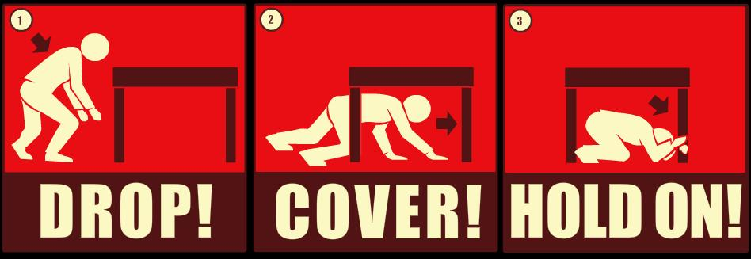
STAGE 3: Orientation prior to the conduct of an earthquake drill
B. Protect Yourself
What to do DURING an Earthquake?
1. Duck, Cover and Hold

Slide 15
STAGE 3: Orientation prior to the conduct of an earthquake drill
2. Watch out for falling objects

Slide 16
STAGE 3: Orientation prior to the conduct of an earthquake drill
3. Keep calm and don’t panic

Slide 17
STAGE 3: Orientation prior to the conduct of an earthquake drill
4. Keep away from glass window and heavy shelves

Slide 18
STAGE 4
Actual Conduct of an Earthquake Drill

Slide 19
STAGE 4: actual conduct of an earthquake drill
Phases of an Earthquake Drill
Phase 1. ALARM
During the drill, the 1-minute alarm indicates earthquake or shaking.
Phase 2. RESPONSE
While the alarm is on-going, everyone should perform “duck, cover and hold”. Remain in this position until the “shaking stops”
Take cover under a sturdy table and hold to your cover until the shaking stops
Use book to cover your head
Hide under an armchair

Slide 20
STAGE 4: actual conduct of an earthquake drill
Phases of an Earthquake Drill
Phase 3. EVACUATION
As soon as the shaking stops, immediately evacuate the school building and proceed to identified evacuation areas using the pre-determined routes guided by the class marshal or teacher.
Get out of the building in an orderly manner
Give the following instructions to students/pupils:
Walk, Do Not Run, Do Not Push, Do Not Talk
Proceed to the identified evacuation area

Slide 21
STAGE 4: actual conduct of an earthquake drill
Phases of an Earthquake Drill
Phase 4. ASSEMBLY
At the designated evacuation area, pupils must be grouped together according to the class where they belong.
Phase 5. HEAD COUNT
Teacher should check and make sure all pupils are accounted for.

Slide 22
STAGE 4: actual conduct of an earthquake drill
Phases of an Earthquake Drill
Phase 6. EVALUATION
The over-all coordinator will announce the termination of drill or “All clear”
An evaluation of the drill must be conducted to identify problems encountered during the drill and how these can be improved in future earthquake drills.
Observers will give their comments and suggestions when all are gathered in the evacuation areas

Slide 23
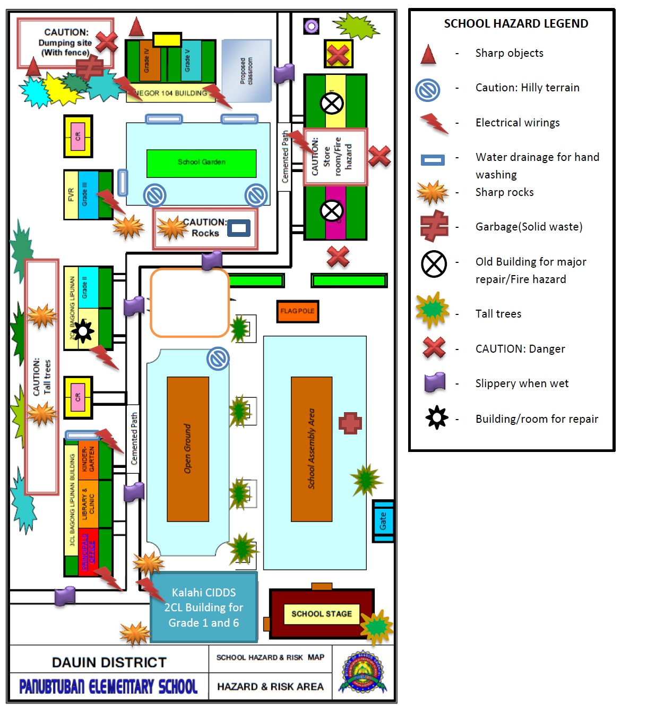

Slide 25
References:
DepEd Order # 84 s. 2012
Philippine Institute of Volcanology and Seismology (PHIVOLCS) - DOST

